Slide 1
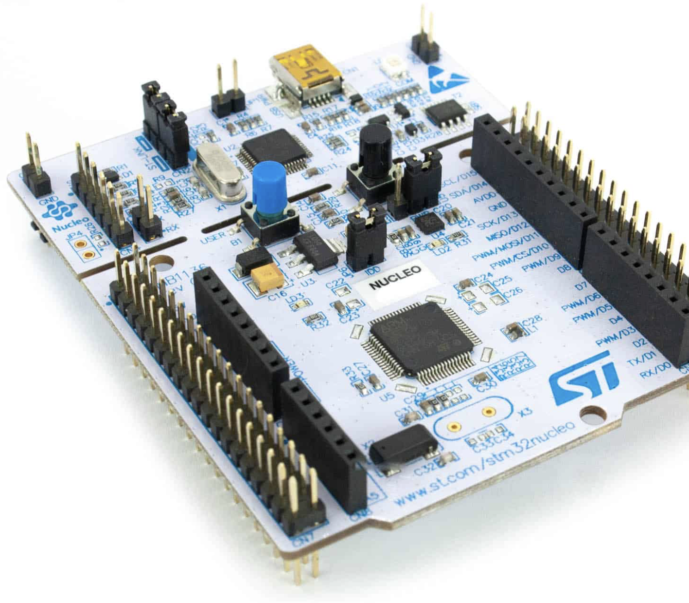

DC Motor Control using PI Controller
Implemented on STM32 Nucleo G474RE using PLECS

Slide 2
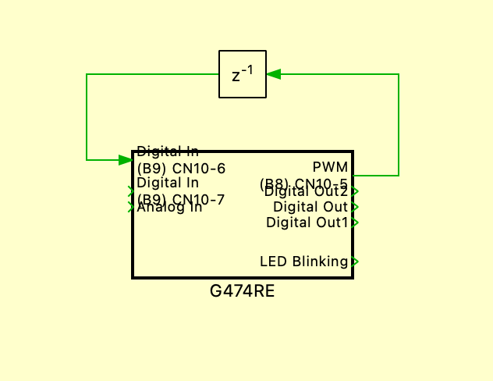
Program in PLECS
The program was created in the PLECS environment and implemented on the STM32 Nucleo G474RE microcontroller. It is designed to control a DC motor using a PI controller. The system simulates a closed-loop speed control, comparing the actual motor speed with a reference speed. The first step is to create a subsystem block with delay.

Slide 3
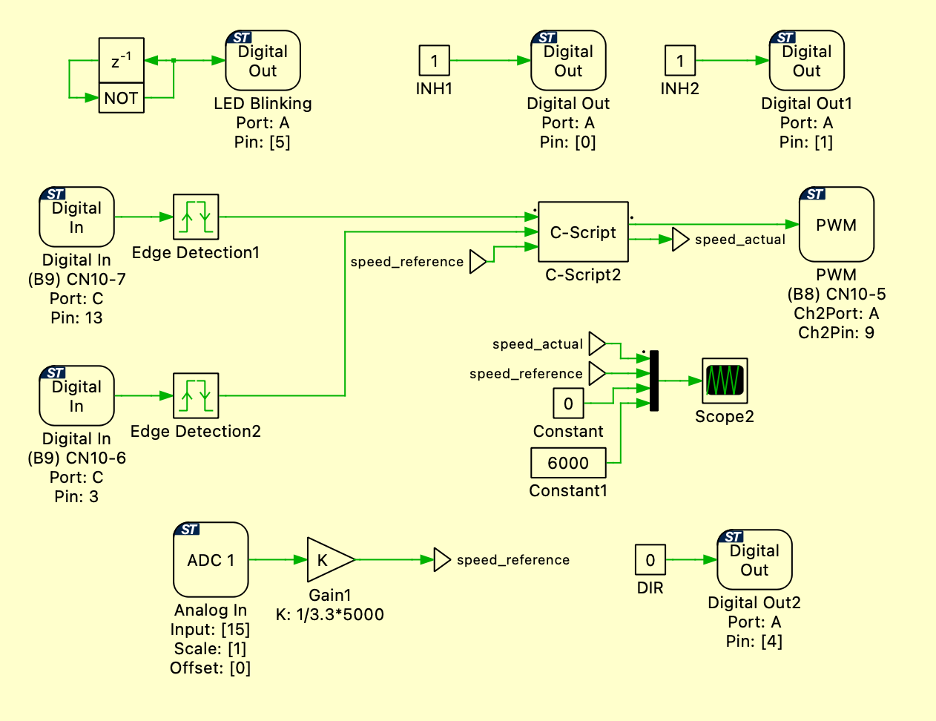

Slide 4
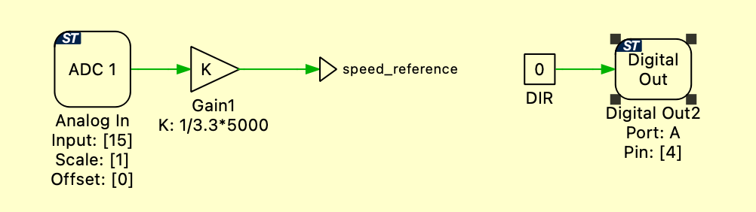
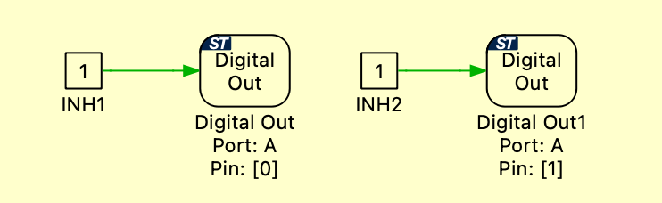
The Analog In block reads a signal from a potentiometer. The value is then processed by dividing it by 3.3 and multiplying by 5000 to obtain the maximum motor speed. The Digital Out 2 block is constantly set to 0 to keep the motor direction unchanged.
The INH1 and INH2 inputs are set to constant logic 1 using DIGITALOUT and DIGITALOUT1 blocks. This means the half-bridge is always enabled.

Slide 5
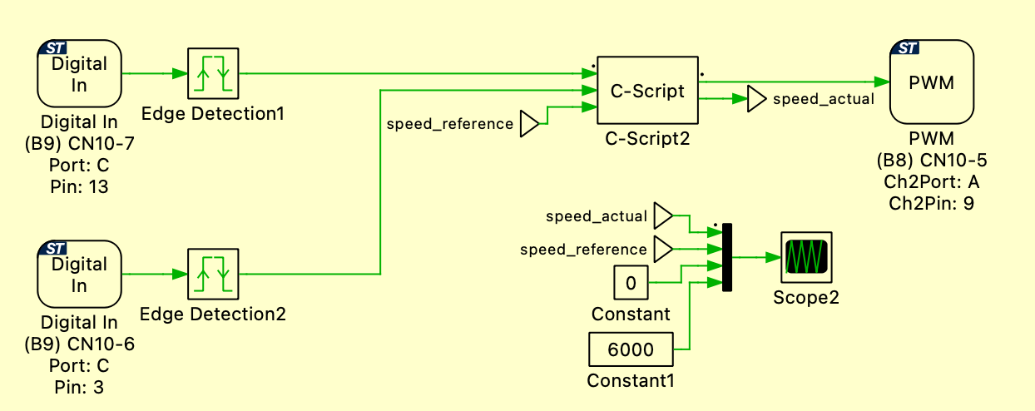
Two digital inputs (Digital In) receive signals from the motor phases and are processed by edge detectors, which detect both rising and falling edges of the encoder pulses. This data is passed to a C-Script block, which implements the logic for counting pulses and calculating the actual rotational speed of the motor (Speed Actual). The calculated speed is then compared to the desired speed (Speed Reference) using a PI controller. The output of the controller is sent to a PWM output, which controls the motor.

Slide 6
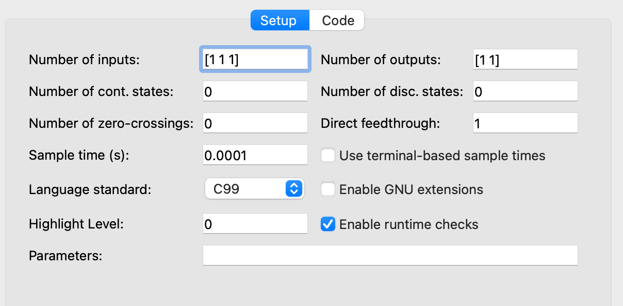
Three inputs are defined: two from edge detectors and one speed reference from the Analog In. Two outputs are used: a PWM signal for motor control and the actual speed (speed_actual) for visualizing the difference from the speed_reference. The sample time is 0.0001 s (10 kHz).

Slide 7
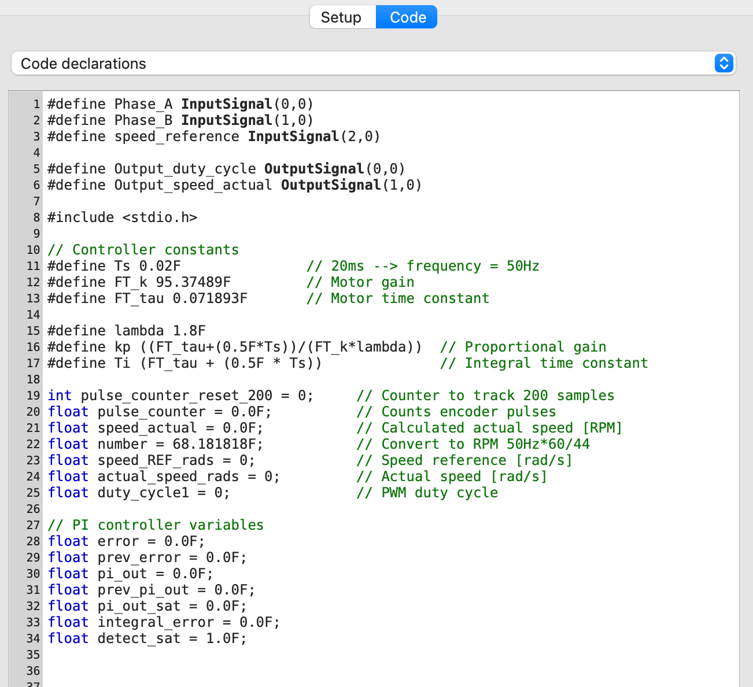
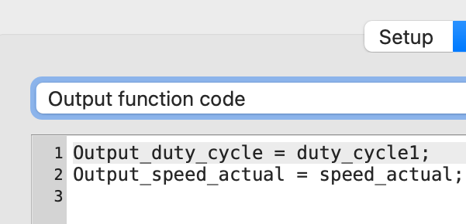

Slide 8
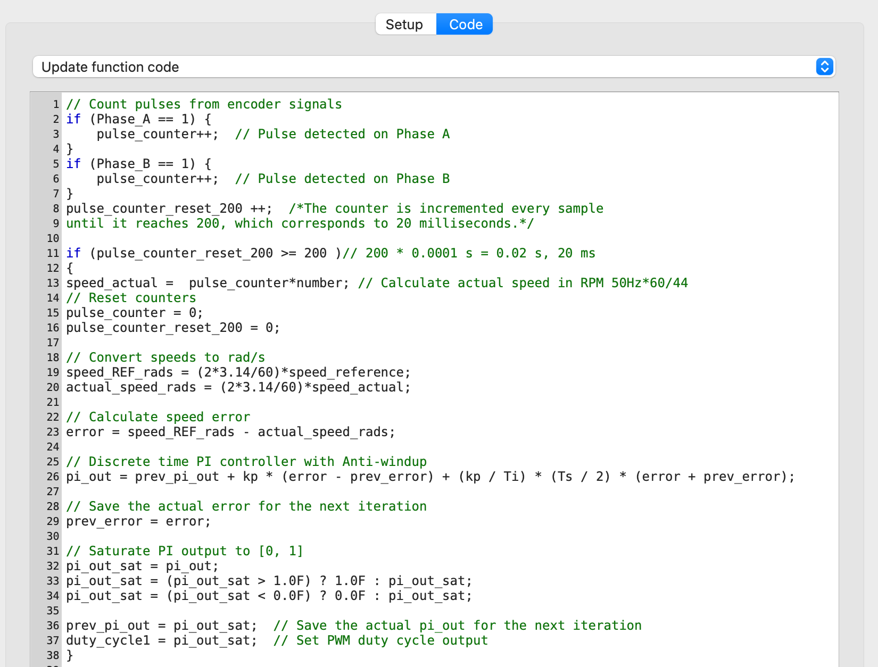

Slide 9
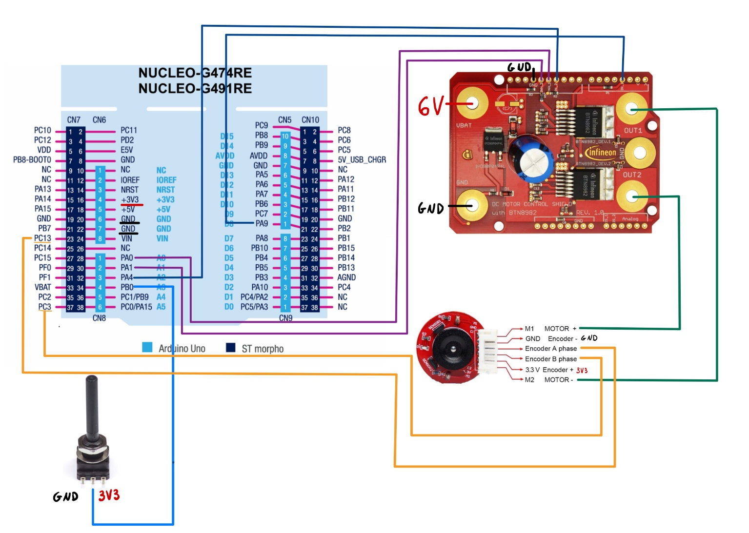
Connection between the microcontroller and the motor

Slide 10
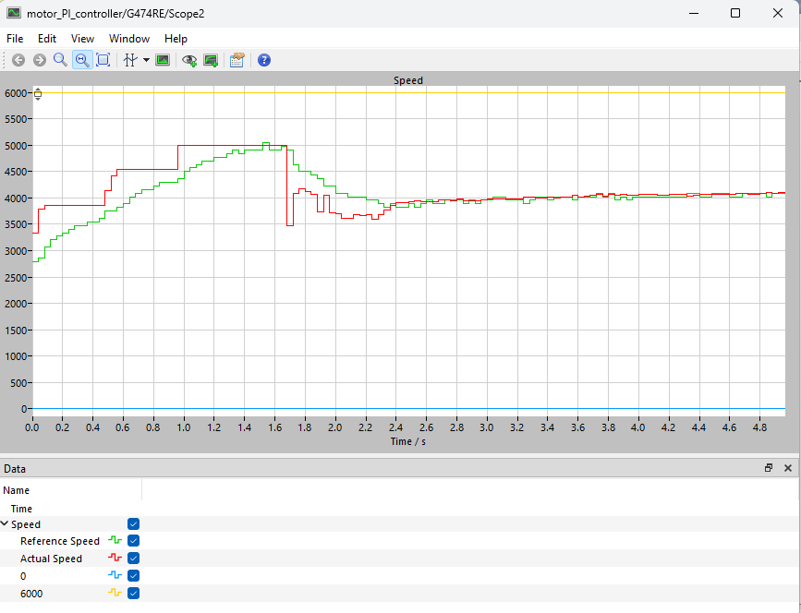

Slide 11
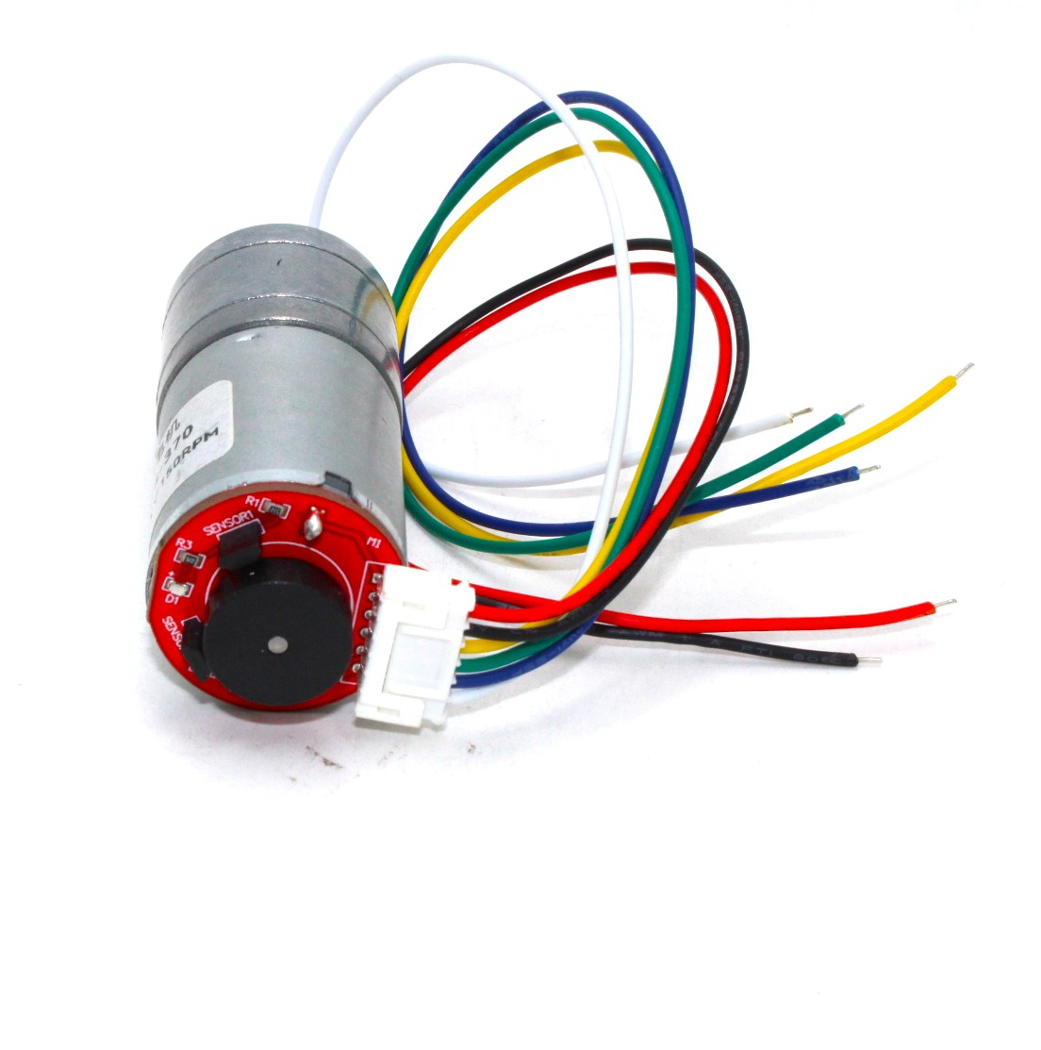
Thank you for your attention!

